Slide 1


CMR TECHNICAL CAMPUS
UGC AUTONOMOUS
Accredited by NBA & NAAC with ‘A’ Grade
Approved by AICTE,New Delhi and affiliated to JNTU,Hyderabad Kandlakoya (V), Medchal Road, Hyderabad -501401, Telangana
Department of Computer Science and Engineering
Major Project Review
PREDICTING STOCK MARKET TRENDS USING MACHINE LEARNING AND DEEP LEARNING ALGORITMS VIA CONTINUOUS AND BINARY DATA
BATCH NO-07
UNDER THE GUIDENCE OF :
S.APARNA
(Assistant Professor)
PRESENTED BY:
Y.SHREYA : 207R1A05P9
A.NITISH : 207R1A05J8
P.SAI KRISHNA : 207R1A0M8

Slide 2
Contents
Abstract
Existing System
Disadvantages of Existing System
Proposed System
Advantages of Proposed System
Hardware and software requirements
Novelty of the project
Architecture
Modules
UML diagrams
Sample code
Result
Conclusion
Future Scope
References
GitHub link

Slide 3
Abstract
This study aims to significantly reduce the risk of trend prediction with machine learning and deep learning algorithms.
Four stock market groups, namely diversified financials, petroleum, non-metallic minerals and basic metals from tehran stock exchange, are chosen for experimental evaluations
This study compares nine machine learning models (Decision Tree, Random Forest, Adaptive Boosting (Adaboost), extreme Gradient Boosting (XGBoost), Support Vector Classifier (SVC), Naïve Bayes, K-Nearest Neighbors (KNN), Logistic Regression and Artificial Neural Network (ANN)) and two powerful deep learning methods
(Recurrent Neural Network (RNN) and Long short-term memory (LSTM).

Slide 4
Existing system
Stock market trends can be affected by external factors such as public sentiment and political events. The sentiment and situation features are used in a machine learning model to find the effect of public sentiment and political situation on the prediction accuracy of algorithms for 7 days in future.
For the sake of experimentation, stock market historical data are downloaded from Yahoo! Finance and public sentiments are obtained from Twitter.
The raw text data are then pre-processed, and the sentiment and situation features are generated to create the final data sets.

Slide 5
Disadvantages of existing system
In the existing work, the system in which Stock market prediction is full of challenges, and data scientists usually confront some problems when they try to develop a predictive model.
This system is less performance in which it is clear that there are always unpredictable factors such as the public image of companies or political situation of countries, which affect stock markets trend.
Less accuracy
Less efficiency

Slide 6
Proposed System
In the proposed system, the system concentrates on comparing prediction performance of nine machine learning models (Decision Tree, Random Forest,Adaboost, XGBoost, SVC, Naïve Bayes, KNN, Logistic Regression and ANN)and two deep learning methods (RNN and LSTM) to predict stock market Movement.
Ten technical indicators are utilized as inputs to our models. The proposed study includes two different approaches for inputs, continuous data and binary data, to investigate the effect of preprocessing; the former uses stock trading.

Slide 7
Advantages of Proposed System
In the proposed system, each of the algorithms can effectively solve stock prediction problems.
To The system is more effective due to presence of extreme Gradient Boosting(XGBoost), Support Vector Classier (SVC) techniques.

Slide 8
Hardware Requirements
For Developing The Application The Following Are The Hardware Requirements:
SYSTEM : i3 OR ABOVE
RAM : 4GB
HARD DISK : 40GB
Software Requirements
For Developing The Application The Following Are The Software Requirements:
OPERATING SYSTEM : WINDOWS 8 OR ABOVE
CODING LANGUAGE : PYTHON

Slide 9
Novelty of the project
Supervised machine learning is a technique used to detect network intrusions. The technique is used on a regular basis in many industries, including information technology, advertising, and online marketing. However, the technique has some limitations.
For example, the technique is used on unstructured data, which may be out of the reach of human players. Additionally, the technique is used with in-house algorithms, which can take time to learn and are not as accurate when it comes to network intrusions.
The novelty of the Supervised Machine Learning technique with feature selection is that it uses a specific algorithm that is able to detect.

Slide 10
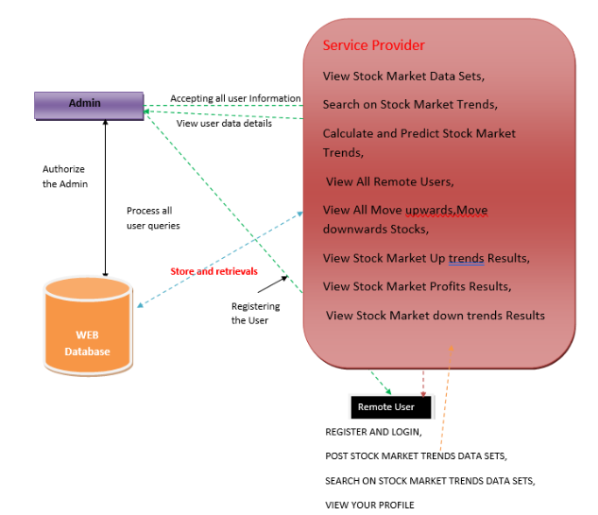
Architecture

Slide 11
Modules
Service Provider:In this module, the Service Provider has to login by using valid user name and password.
View and authorize users:In this module, the admin can view the list of users who all registered
Remote users:In this module, there are n numbers of users are present. User should register before doing any operations.

Slide 12
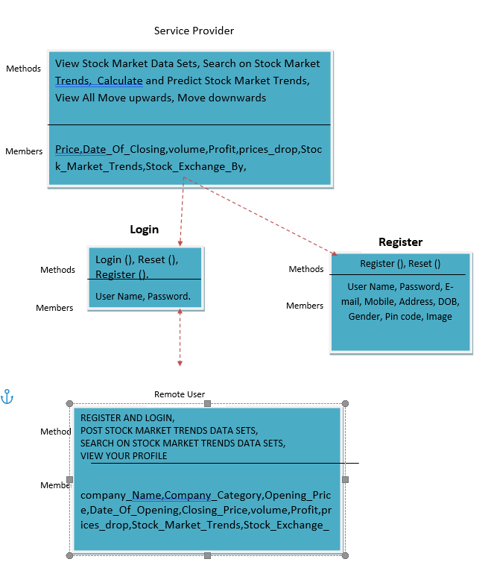
UML DAIGRAMS Class diagram

Slide 13
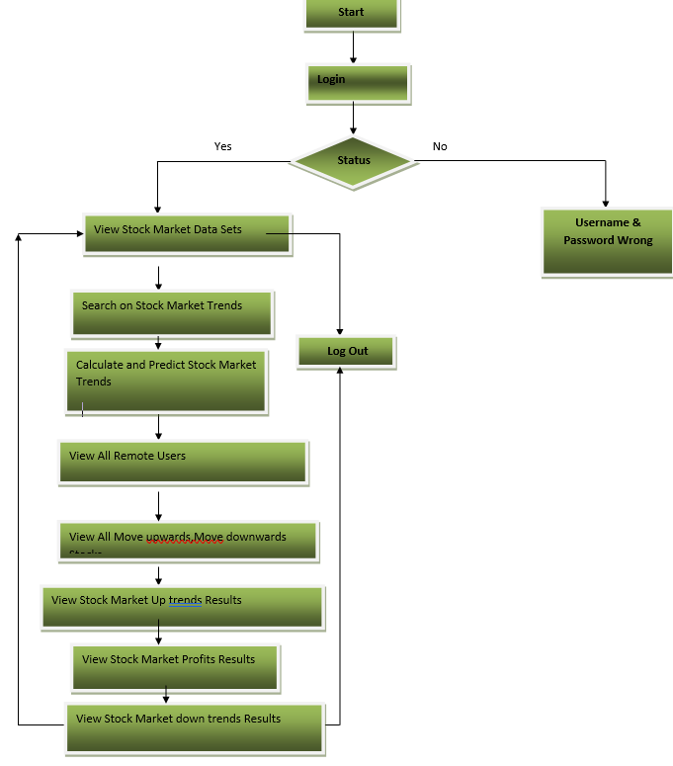
Activity diagram

Slide 14
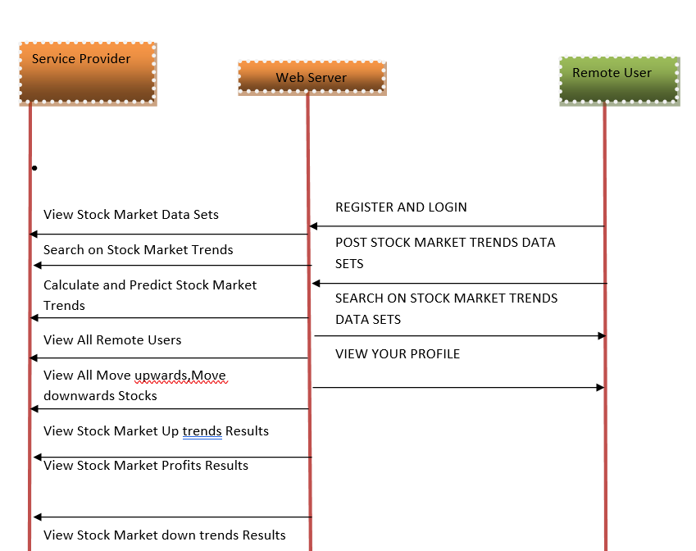
SEQUENCE DIAGRAM

Slide 15
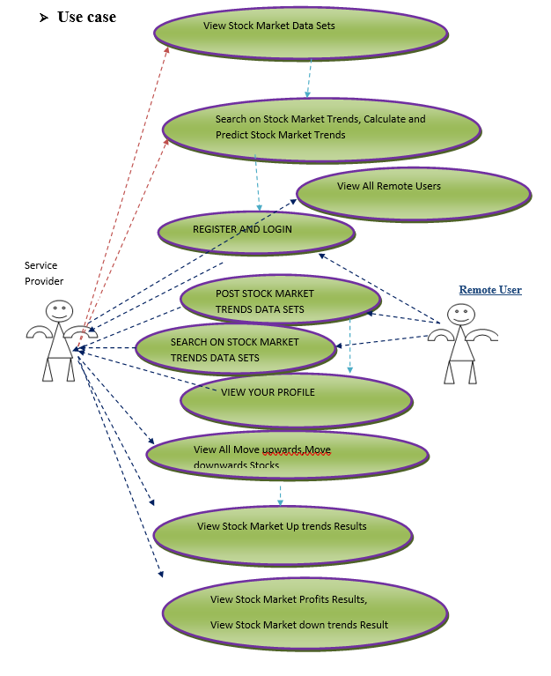
Usecase diagram

Slide 16
Sample code
import os
from django.core.asgi import get_asgi_application
os.environ.setdefault('DJANGO_SETTINGS_MODULE', 'predicting_stock_markettrends.settings')
application = get_asgi_application()
def main():
"""Run administrative tasks."""
os.environ.setdefault('DJANGO_SETTINGS_MODULE', 'predicting_stock_markettrends.settings')
try:
from django.core.management import execute_from_command_line
except ImportError as exc:
raise ImportError(
"Couldn't import Django. Are you sure it's installed and "
"available on your PYTHONPATH environment variable? Did you "
"forget to activate a virtual environment?"

Slide 17
'OPTIONS': {
'context_processors': [
'django.template.context_processors.debug',
'django.template.context_processors.request',
'django.contrib.auth.context_processors.auth',
'django.contrib.messages.context_processors.messages',
],
},
},
]
from django.conf.urls import url
from django.contrib import admin
from Remote_User import views as remoteuser
from predicting_stock_markettrends import settings
from Service_Provider import views as serviceprovider
from django.conf.urls.static import static
urlpatterns = [
url('admin/', admin.site.urls),
url(r'^$', remoteuser.login, name="login"),
url(r'^Register1/$', remoteuser.Register1, name="Register1"),
url(r'^Search_StockMarket_DataSets/$', remoteuser.Search_StockMarket_DataSets, name="Search_StockMarket_DataSets"),
url(r'^ratings/(?P<pk>\d+)/$', remoteuser.ratings, name="ratings"),

Slide 18
url(r'View_Remote_Users/$',serviceprovider.View_Remote_Users,name="View_Remote_Users"),
url(r'^charts/(?P<chart_type>\w+)', serviceprovider.charts,name="charts"),
url(r'^charts1/(?P<chart_type>\w+)', serviceprovider.charts1, name="charts1"),
url(r'^likeschart/(?P<like_chart>\w+)', serviceprovider.likeschart, name="likeschart"),
url(r'^Search_StockMarket/$', serviceprovider.Search_StockMarket, name="Search_StockMarket"),
url(r'^ViewYourProfile/$', remoteuser.ViewYourProfile, name="ViewYourProfile"),
url(r'^Add_DataSet_Details/$', remoteuser.Add_DataSet_Details, name="Add_DataSet_Details"),
url(r'^serviceproviderlogin/$',serviceprovider.serviceproviderlogin, name="serviceproviderlogin"),

Slide 19
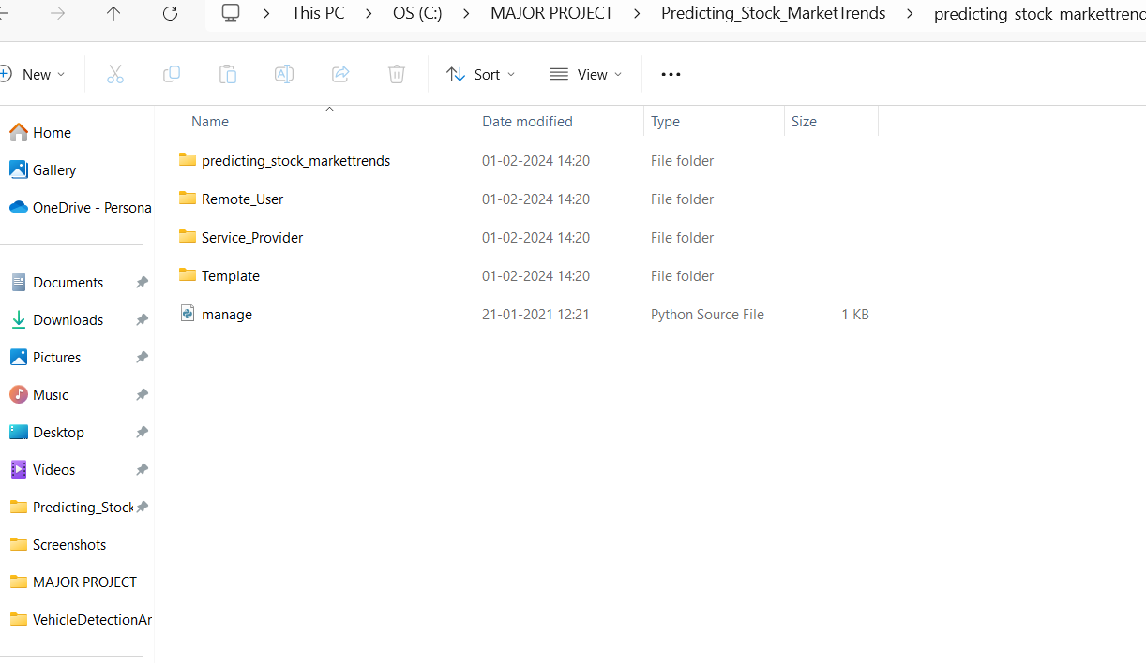
Result

Slide 20
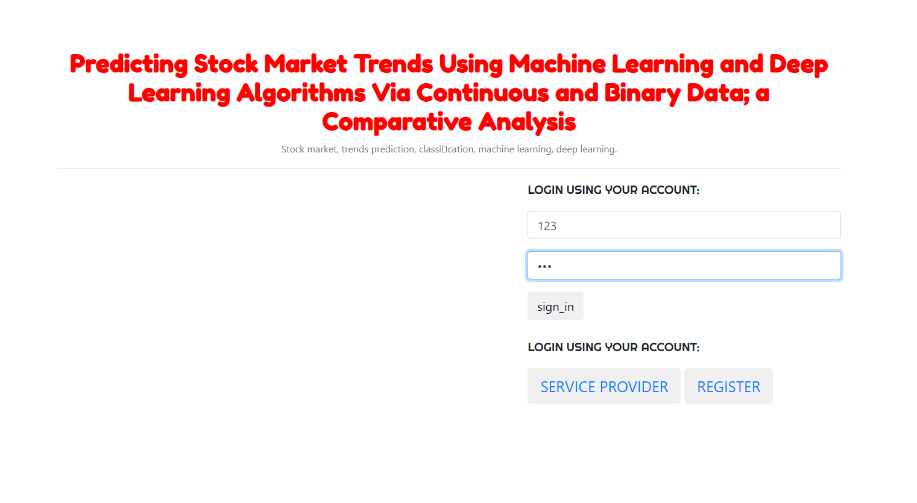

Slide 21
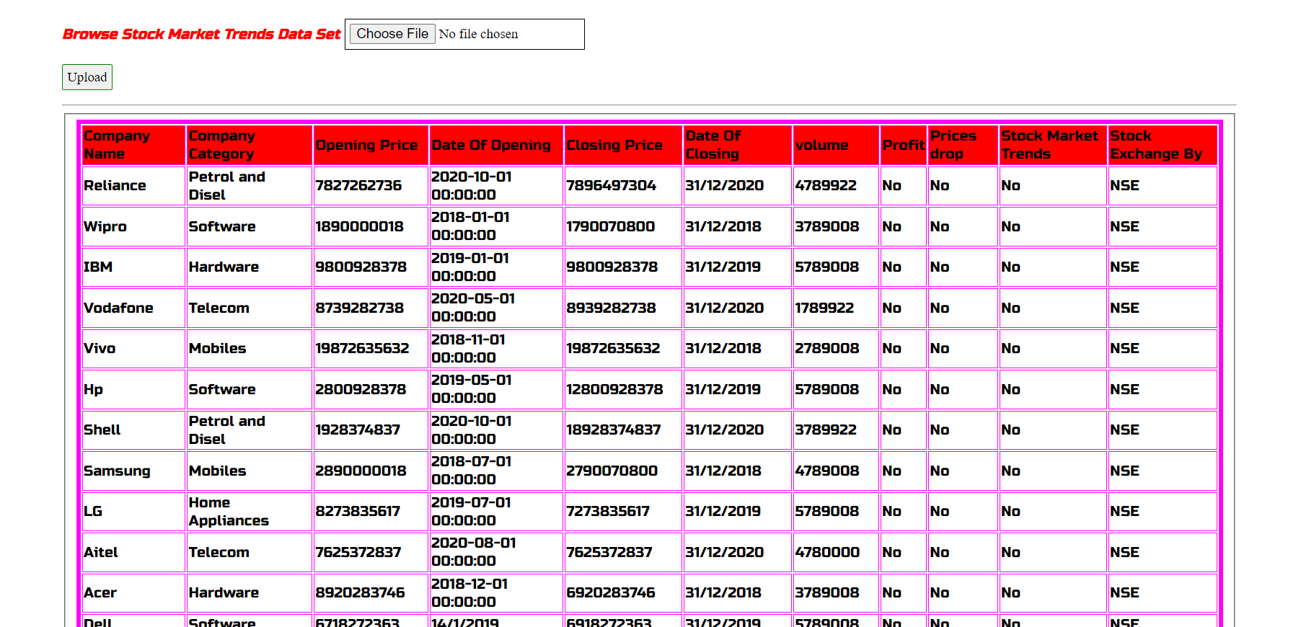

Slide 22
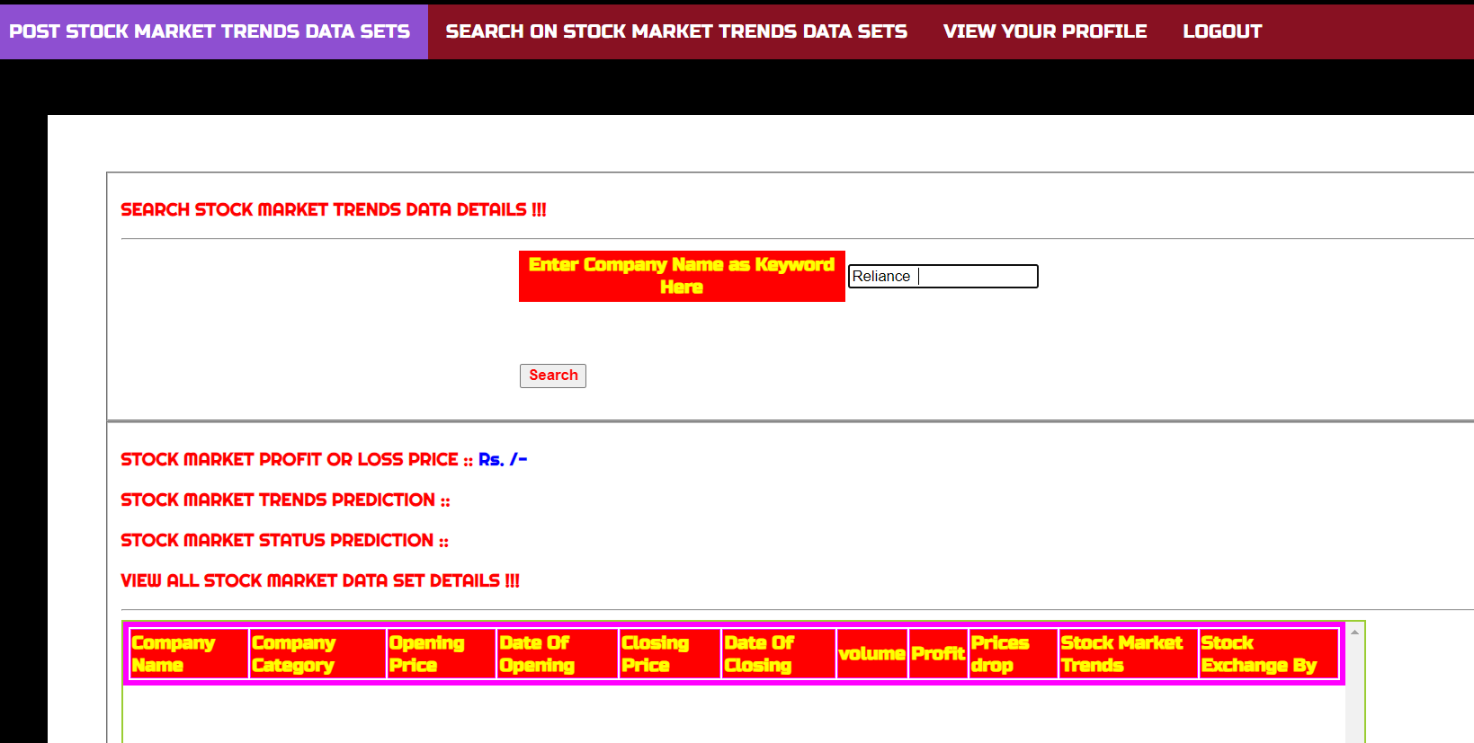

Slide 23
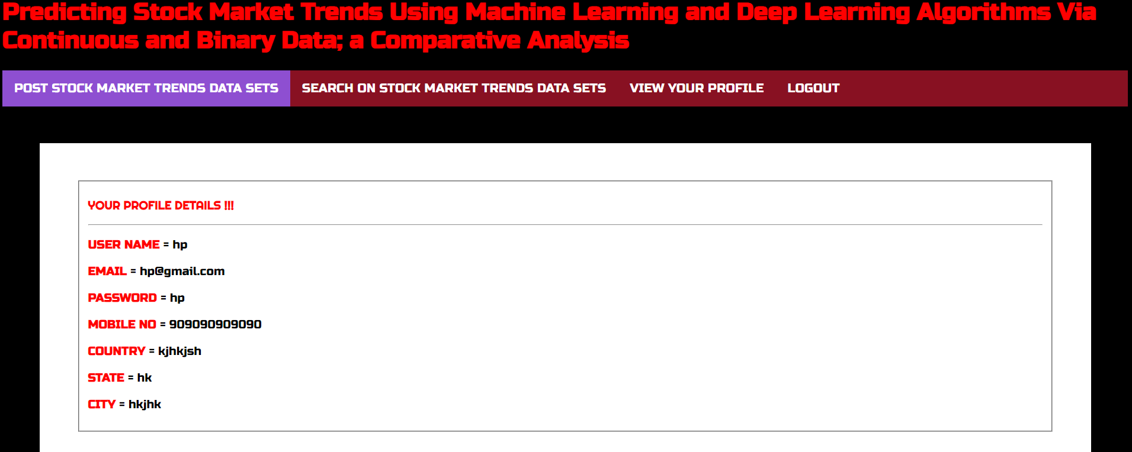

Slide 24
Conclusion
The purpose of this study was the prediction task of stock market movement by machine learning and deep learning algorithms.
Our experimental works showed that there was significant improvement in the performance of models when they use binary data instead of continuous one. Indeed, deep learning algorithms (RNN and LSTM) were our superior models in both approaches.

Slide 25
Future Scope
The future scope for predicting stock market trends using machine learning and deep learning algorithms via continuous and binary data is vast and multi-faceted. Continued research and innovation in this field hold the potential to revolutionize how investors make decisions and navigate financial markets
Future research may address issues related to model bias, fairness, and robustness to adversarial attacks. Techniques such as adversarial training, fairness-aware learning, and model regularization could be employed to mitigate these concerns.

Slide 26
References
1.J. Murphy, Technical Analysis of the Financial Markets: A Comprehen-sive Guide to Trading Methods and Applications. Penguin, 1999.
2. T. Turner, A Beginner's Guide To Day Trading Online, 2nd ed. New York,
NY, USA: Simon and Schuster, 2007.
3. H. Maqsood, I. Mehmood, M. Maqsood, M. Yasir, S. Afzal, F. Aadil,M. M. Selim, and K. Muhammad, ``A local and global event sentimentbased efcient stock exchange forecasting using deep learning,'' Int. J. Inf.
Manage., vol. 50, pp. 432451, Feb. 2020.
4. J. B. Duarte Duarte, L. H. Talero Sarmiento, and K. J. Sierra Juárez,``Evaluation of the effect of investor psychology on an articial stock market through its degree of efciency,'' Contaduría y Administración,vol. 62, no. 4, pp. 13611376, Oct. 2017.

Slide 27
Github link

Slide 28
Thank you.

